Slide 1
Dufurrena Ponds - 2013
French Ford Middle School –
A FEW HIGHLIGHTS FROM OUR TRIP
“Thank you, so much. If you wouldn’t have given us the money then I never would have learned that much in a day.”
Isabelle

Slide 2
On May 9, 2013 about 120 fifth grade students from French Ford Middle School loaded onto two busses and made the 125- mile trip to Dufurrena Ponds.
Thanks to the GSN Foundation for making the trip possible through generous grant contributions.
“The drive was long, but the trip was worth it”
Laci

Slide 3
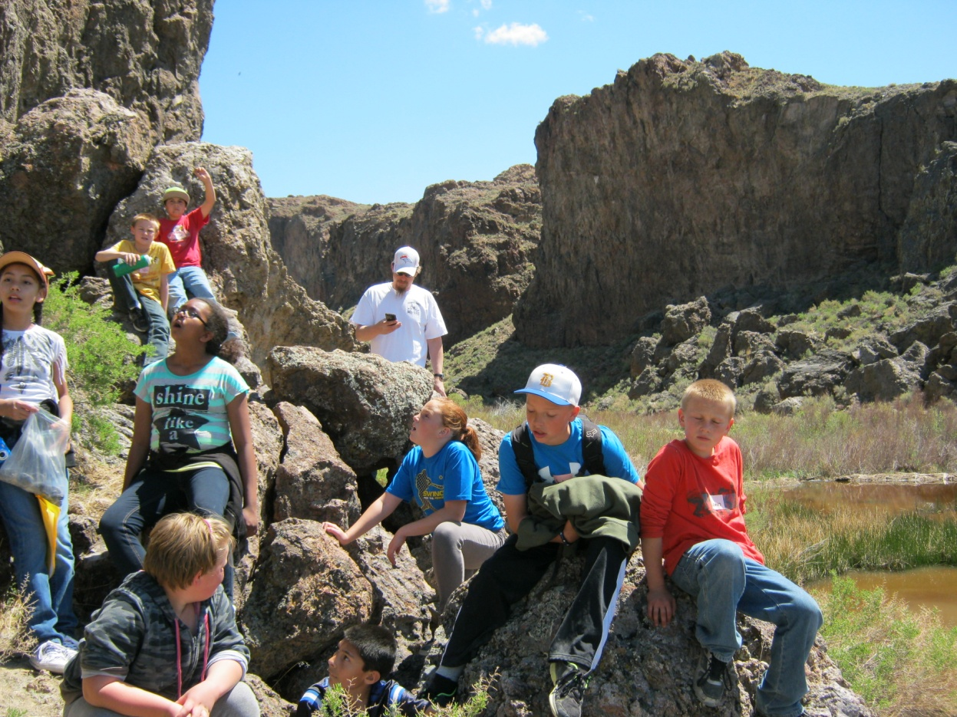
Station 1 Head of Thousand Creeks Gorge
“I loved learning about the rocks and how some of the rocks were made from volcanic activity. It looked like the rocks had some kind of bubbles in them, but they actually had these holes from being hot and cooling. I also never knew that the Thousand Creeks Gorge was made by volcanoes“
Destiny

Slide 4
Station 1 Head of Thousand Creeks Gorge
“The best part of Dufurrena Ponds was the caldera. The water was pretty, it was orange and different colors.”
Jordan
We found a pond that had red water because the iron was washed from the (rocks).”
Ron

Slide 5
Station 2 Sandstone Quarry
“I liked the trip to the quarry. I liked all the different patterns in the rocks. I liked all the sizes and colors of the rocks. A girl I know found a huge chunk of obsidian. My major (thing I liked) was the rock cutter.”
Alisha
Mr. Munk showing students the rock-cutting machine at the quarry.

Slide 6
Station 2 Sandstone Quarry
“It was cool to see where the natives broke the sandstone, and the old machines.”
Jeremiah

Slide 7
Station 3 Animals
“The animal life there was pretty amazing. We saw a pack of antelope.”
Angel
“Next to the sand rocks, I saw a toad. I also saw a bull snake, it was so cool.”
Natalia
Mr. Clark talking about the animals found in the area.

Slide 8
Station 4 Water Cycle
Making water cycle bracelets with Mrs. McCord

Slide 9
“After seeing all those different kinds of rocks I think that I want to be a geologist when I grow up.” Laci
“I found a whole bunch of obsidian, lava rock and other cool rocks”
James
“I actually found lava that shooted from the volcano, then cooled when falling, then turned into rock when it hit the ground.” Polaris

Slide 10
“The fish in the pool are cool! Especially the little fish. When you put your hand in the water it tickles because they eat the dead skin cells.” Victor
“They showed us the hot springs showers. We saw a big fish in the hot springs pool”
Aldahir

Slide 11
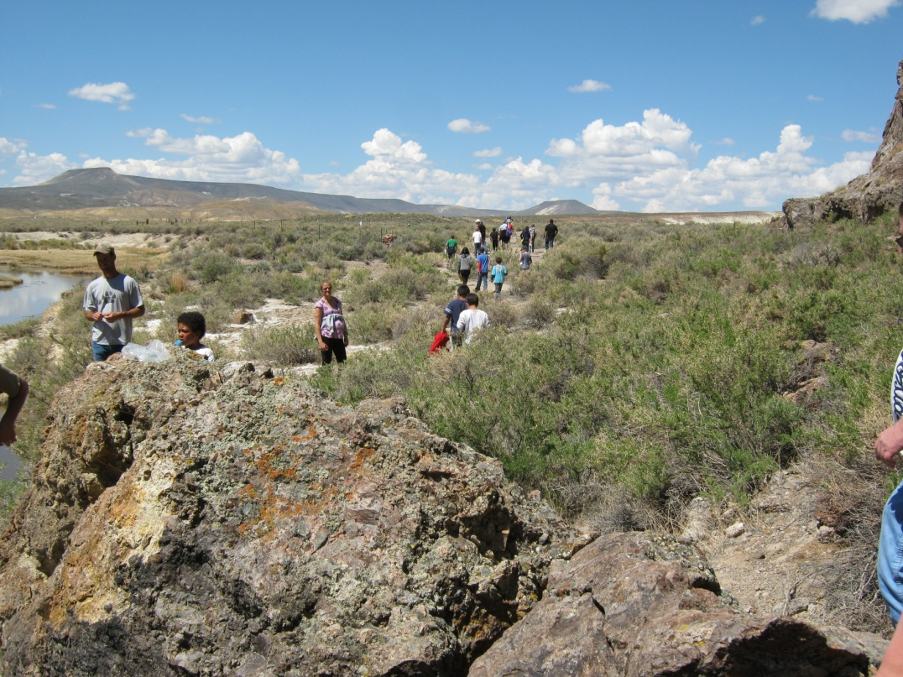
Hanging out at the shower house.
Walking to the gorge.

Slide 12
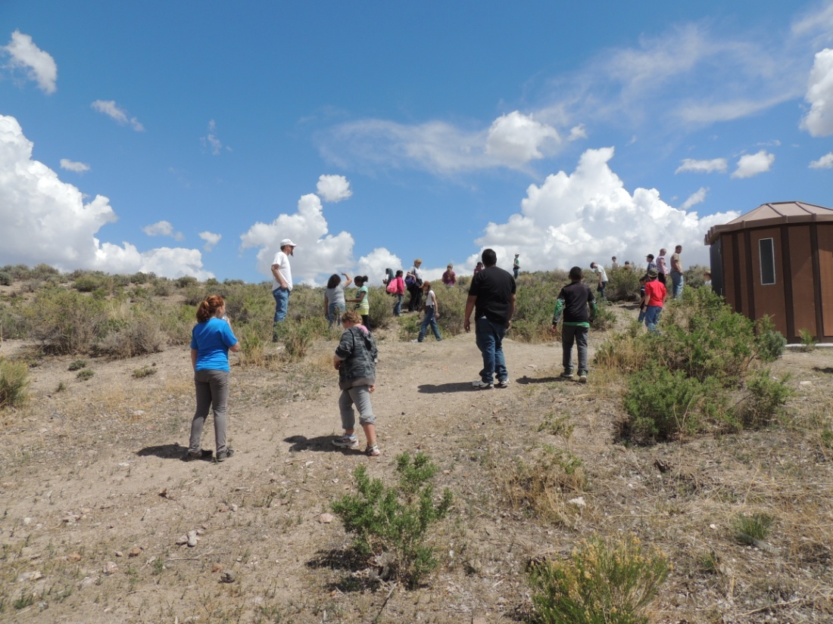
Looking for souvenirs

